Slide 1
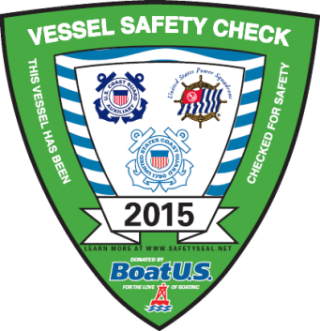
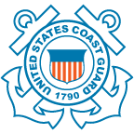
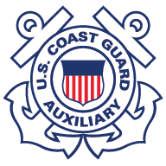
2015 VSC WORKSHOP
Presented by: The National Directorate of Vessel Examination and Recreational Boating Safety Visitation Programs

Slide 2
Workshop Objectives
To provide our Vessel Examiners with the most current, up-to-date rules, regulations, and laws available to assist them in educating the recreational boater during vessel safety checks
This year we have tailored the workshop to review the recent changes/additions outlined in the NEW Vessel Safety Check Manual (COMDTINST M16796.8A)
There are several subtle, and important changes in the manual that will be discussed

Slide 3
National RBS Program Mission
Statement
To minimize loss of life, personal injury, property damage, and the environmental impact associated with the use of recreational boats through preventative means to maximize the safe use and enjoyment of United States waterways by the public.
RBS is Job #1

Slide 4
The Vessel Safety Check Program continues to be the primary method to help boaters achieve voluntary compliance with federal and state recreational boating laws.
THE VSC IS A TWO PRONGED APPROACH TO BOATING SAFETY
1. ENSURES CARRIAGE OF THE REQUIRED SAFETY EQUIPMENT.
2. RAISES THE BOATER’S AWARENESS THROUGH ONE-ON-ONE CONTACT.
What a better time than during a vessel safety check to introduce the boater to the Coast Guard Auxiliary’s “classroom” and “E-Courses” Public Education Programs.

Slide 5
Reviewing the New VSC Manual
FORMAT
TERMINOLOGY
REVIEWING THE MANUAL
NEW CHAPTERS
UNIFORMS
WEARING LIFE JACKETS
CERTIFICATION / RECERTIFICATION
BELL REQUIREMENTS
REQUIREMENTS FOR BATTERY TERMINALS
MARPOL TRASH PLACARD
OIL POLLUTION PLACARD
LATEST UPDATES – NAVRULES, BACKFIRE FLAME ARRESTOR SUPPLEMENT

Slide 6
Terminology
Wording throughout the manual is written to make careful use of the words:
SHALL
MAY
SHOULD
MUST

Slide 7
“Shall”
“Where the word shall appears in the text, it means that vessel examiners are specifically required to take a particular action.“
“By the same token, the phrase shall not means
they are prohibited from taking that action.”
For example: “At the end of each vessel safety check, vessel examiners shall give the operator of the vessel a copy of the completed Vessel Safety Check, Form ANSC 7012.”
That means the vessel examiner is required to do so, according to the procedures for conducting a vessel safety check that have been promulgated by the U.S. Coast Guard.

Slide 8
“May”
The word may means that the practice or action described is only a suggestion or an option for the vessel examiner or the boater, and not a requirement for obtaining a decal.

Slide 9
“Should”
“When the word should is used, it means that the procedure or option that follows it is strongly recommended by the U.S. Coast Guard as a preferred boating safety practice, but is not required for the vessel to qualify for a vessel safety check decal.”
Vessel examiners are prohibited from denying a vessel safety check decal as long as the vessel meets the requirements specified in the list of VSC decal requirements. The vessel does not have to have the recommended and discussion items listed on the Vessel Safety Check Form ANSC 7012/7012a.

Slide 10
“Must”
The word must is used to signify that a vessel has to carry a specific piece of equipment, or that the equipment has to be labeled or used in a specific way in order to meet U.S. Coast Guard standards and to qualify for a vessel safety check decal.
Example: “To qualify, a life jacket must be in good and serviceable condition and contain a label showing that it has been approved by the U.S. Coast Guard.”

Slide 11
Reviewing the Manual
The next time you review the manual, remember to keep the four words we just discussed in mind.
SHALL – MAY – SHOULD – MUST
They will help you gain a better understanding in the intent of the vessel safety check and hopefully do away with previous gray areas.

Slide 12
New Chapters in the Manual
Chapter 5: Paddle Craft
Chapter 6: Operational Facilities
Rather than needing to refer to a separate manual or addendum, everything is located in one clear and concise location. This will make it easier for new members training to be a Vessel Examiner.

Slide 13
Chapter 5 – Paddle Craft
This chapter outlines specific paddle craft VSC requirements and provides valuable information for the Vessel Examiner not familiar with paddle craft.
It also provides insight and tips into additional recommended equipment and topics to discuss with paddlers, allowing for a more educational
one-on-one interaction.

Slide 14
Chapter 6 – Operational Facilities
This chapter is designed to aid the Vessel Examiner in understanding the related paperwork and requirements necessary to offer a vessel as an Operational Facility.
All Operational Facilities must first meet the standards for a vessel safety check, and then are required to meet the Operational Facility requirements as outlined on ANSC form 7003 (ANSC form 7008 for PWC’s)
Note: The District Commander (through the DIRAUX) may specify additional requirements and equipment to support Auxiliary operations. Always check with your specific district for details.

Slide 15
Uniforms
Changes in policy:
Whether they are members of the Auxiliary or the Power Squadrons, vessel examiners shall wear the appropriate uniform or authorized clothing when conducting scheduled vessel safety checks or participating in a Vessel Safety Check Day event.
“The Uniform of the Day for Auxiliarists performing vessel safety checks is the Operational Dress Uniform (ODU). The optional Vessel Examiner polo shirt or the hot weather uniform prescribed in the Auxiliary Manual, COMDTINST M16790.1 (series) may be worn while conducting Vessel Safety Checks.”
(Districts vary regarding wearing the Hot Weather Uniform)

Slide 16


Wearing Life Jackets
Policy Change:
“Auxiliarists shall wear a life jacket while conducting vessel safety checks on vessels that are in the water…and are encouraged to do so during classroom training to promote their use among the boating public.”

Slide 17
Certification & Recertification of Vessel Examiners
There are no changes.
The new manual simply adds clarification.
Let’s take a minute to review the process.

Slide 18
Initial VE Qualification
Shall Hold “BQ” Status in AUXDATA
  Auxiliarists in AP status may qualify after meeting requirements as outlined in the Auxiliary Manual (COMDTINST M 16790.1– ref: 3.D.2.f)
Shall take and pass the open book VE Qualification Examination
  Three (3) hour time limit
  Passing score of 90%
Shall conduct five (5) VSC’s under the supervision of a certified VE
  Examinations using ANSC Form 7012A are NOT authorized
During the qualification process the certified VE is credited with the VSC’s performed

Slide 19
Annual Certification
Complete a minimum of five (5) Vessel Safety Checks using ANSC forms 7012/7012a. This also includes OPFAC inspections
Completion of a mandatory workshop, if so designated by NEXCOM
Vessel Examiners would be notified well in advance
Minimum of
VSC’s Annually

Slide 20
Recertification
“If any qualified vessel examiner fails to perform the annual certification procedures within the last year, they must complete two satisfactory vessel safety checks, as a trainee, under the supervision of a certified vessel examiner utilizing the Vessel Safety Check, Form ANSC 7012. Paddle craft examinations using ANSC 7012 A are not authorized.” Performing OPFAC inspections are also counted toward the required examinations.
“Only the certified vessel examiner receives the credit for the two recertification vessel safety checks.”
“The Auxiliarist must then complete the annual certification procedures to retain certification for the following year.”
2
5
VSC’s after Recertified to meet Annual Requirement
Supervised VSC’s to get Recertified
THEN

Slide 21
Loss of Qualification
If a vessel examiner fails to perform the annual certification procedures for five (5) consecutive years, that member must complete the full initial certification process to regain qualification.

Slide 22
Bell Requirements
Again nothing new.
Simply brings the VSC manual up to date with current Navigational Rules (NAVRULES).
Vessels examined under the current vessel safety check requirements are not required to carry a bell.
Note: The Navigational Rules: International – Inland, will NO longer be available from the government in a hard copy version. They will only be available in an electronic version.

Slide 23
Batteries
“Batteries should be secured and terminals covered to prevent accidental arcing. Covering just the positive terminal is acceptable to prevent accidental arcing”
Some states may require that both the positive and negative terminals be covered to prevent accidental arcing
IMPORTANT ADDITION/CLARIFICATION
Vessels with outboard motors are exempt from this requirement

Slide 24
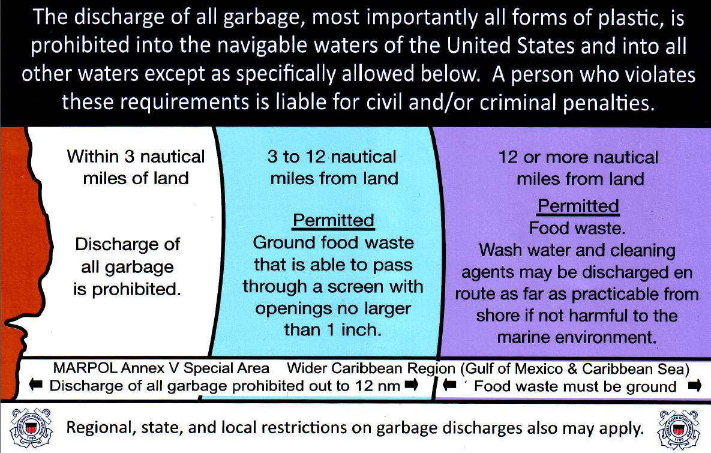
New Marpol Trash Placard
The new manual helps to clarify the MARPOL Plaque requirement
“United States vessels 26 feet or longer must display in a prominent location a durable placard notifying the crew and passengers of the discharge restrictions”
The specific Marpol Placard size and language is not specified. However, the new Marpol Placard is shown above and available from ANSC. Order ANSC #4067 - STICKER, "GARBAGE DUMPING RESTRICTIONS" (5½"x 8½") OFFSHORE. Similar placards are also available for purchase from retail outlets.
Regardless a vessel that is required to display a Marpol Placard…Must have a Marpol Placard displayed (new or old)

Slide 25
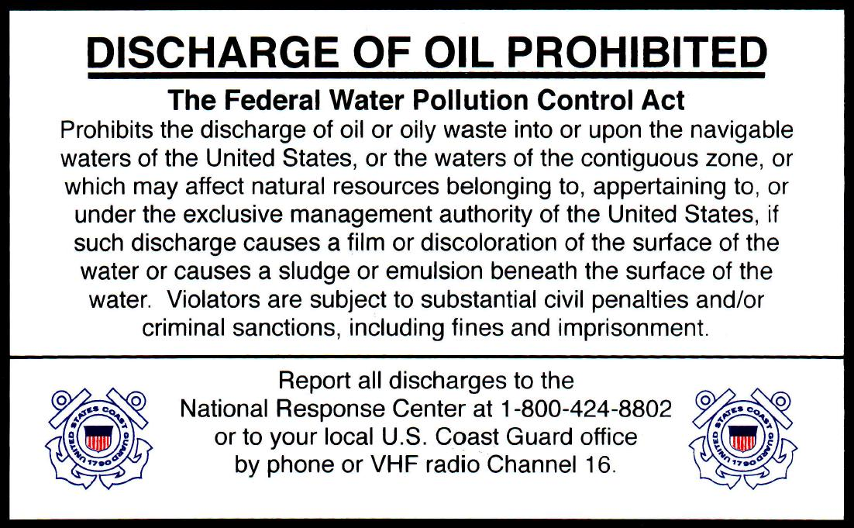
Pollution Placard
Vessel Examiners that conduct VSC’s on vessels that require an new Oil Pollution Placard can order them from ANSC. Similar placards are also available for purchase from retail outlets.
Order info: ANSC#4064 - STICKER, DISCHARGE OF OIL PROHIBITED FWPCA (5" x 8") - Information on discharge of oil or oily waste into or upon the navigable waters of the United States.

Slide 26
NAVRULES
ALCOAST 411-2014
CLARIFICATION ON CARRIAGE OF ELECTRONIC NAVIGATION RULES
Vessel operators are reminded that 33 CFR 83.01(g) requires: The operator of each self-propelled vessel 39.4 FEET (12 meters) or more in length shall carry on board, and maintain for ready reference, a copy of these Rules.
The Navigation Rules book…..allows the electronic format of specific navigation publications.

Slide 27
NAVRULES cont’d
The impediment to allowing an electronic copy of the Navigation Rules is the requirement for access and "ready reference". The rule of thumb for "ready reference" means that vessel operators must be able to open up the book in two minutes or less. Such access is challenging for many electronic devices, especially if they are on a computer or laptop.
FOR FURTHER CLARIFICATION PLEASE REFER TO:
NATIONAL V-DIRECTORATE WEBSITE FOR POSTING OF ALCOAST 380/14
PROMUGLATION OF THE NAVIGATIONAL RULES AND REGULATIONS HANDBOOK

Slide 28
Supplement to New Manual
Found on V-Directorate Website
“Gas engines installed in a motor boat or motor vessel after April 25, 1940, except outboard motors, must be equipped with an acceptable backfire flame control. The backfire flame arrester must be suitable secured to the intake with a flame tight connection and is required to be either USCG approved or comply with SAE J-1928 or UL 111 standards and marked accordingly.”
Refer to the actual manual supplement regarding other acceptable flame controls including air induction systems, velocity stacks and reed type backfire flame arresters

Slide 29
New VSC Manual
COMDTINST M16796.8A
The new VSC Manual, COMDTINST M16796.8A is only being released in electronic format by the Coast Guard.
Some Vessel Examiners may wish to have the manual available as a “Hard Copy” reference. The CG Auxiliary Association has made arrangements to have our manuals printed at discount rates. To take advantage of this offer…
PLEASE SEE THE DIRECTOR-V’s MEMO ON THE WHAT’S NEW PAGE, LOCATED ON THE V-DIRECTORATE’S NATIONAL WEB SITE
Or go directly to:
http://wow.uscgaux.info/content.php?unit=V-DEPT&category=dir-v-says

Slide 30
It’s Important – You’re Important
Some take always…
Let’s make the most of our one-on-one time while talking with boaters.
BE SURE TO STRESS THE IMPORTANCE OF TAKING AN AUXILIARY CLASSROOM OR AUXILIARY E-COURSE BOATER SAFETY CLASS.
The information “YOU” pass along may well prevent an
accident or save a life.
YOU ARE AN AMBASSADOR REPRESENTING THE U.S. COAST GUARD AND U.S. COAST GUARD AUXILIARY.
“SEMPER PARATUS”

Slide 31
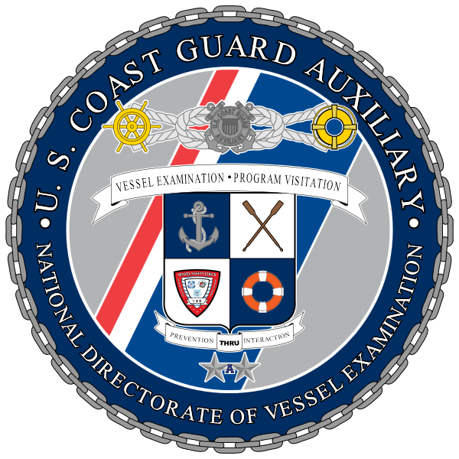
2015 V-DIRECTORATE
STAFF
“Prevention Through Interaction”
Director-V: Michael S. Klacik
Deputy Director-V: Andrew J. Render
Division Chief-Vessel Examination:
Division Chief-Visitation Programs: Joseph C. Reichal Jr.
Division Chief-Communications: William J. Howard
Division Chief- Incentives: Norman L. Fehr Jr.
Division Chief-Technical Services: John Yskamp

